Slide 1
AUTONOMOUS IT
Automation in Software Testing

Slide 2
PROBLEM STATEMENT:
One of the Retail customer is looking to automate various phases of Infrastructure Lifecycle i.e., Design, Build, Operate & Optimize. Overall objectives of the Autonomous Infrastructure are to improve agility of the business requirement and reduce manual intervention while managing the overall lifecycle of application. Overall solution should consist of
Create the WordPress application stack – 2 Servers, 1 ELB (1-LB, 1-Apache PHP, 1- MySql)
Patch the system to latest kernel and security updates
Create the test Blog site
Create self-healing automation which will monitor the Apache-PHP and MySQL process and in case it is not running/hung it will stop/start the daemon/process.
Add Apache-PHP server in case of increase in CPU utilization above 70-80% .

Slide 3
SOFTWARE REQUIREMENTS:
Operating System – Linux (Ubuntu).
Ansible.
Linux, Apache server, MySQL, PHP (Lamp stack).
Wordpress.
AWS Lightsail Instance with ubuntu.

Slide 4
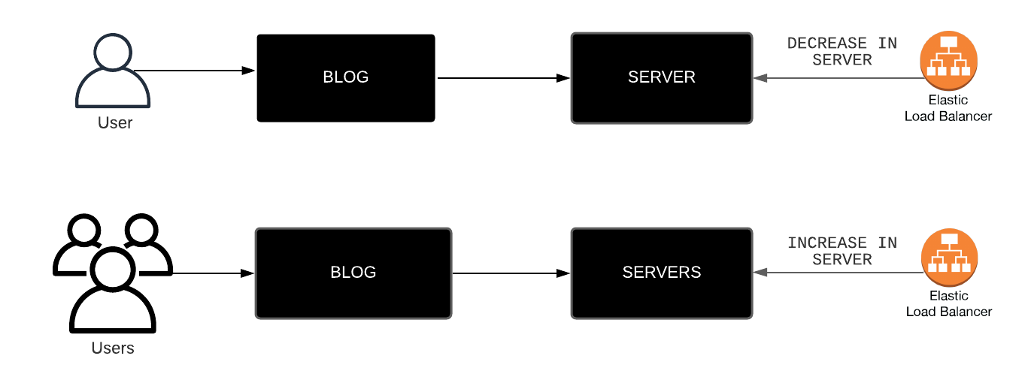
OVERALL WORKFLOW:

Slide 5
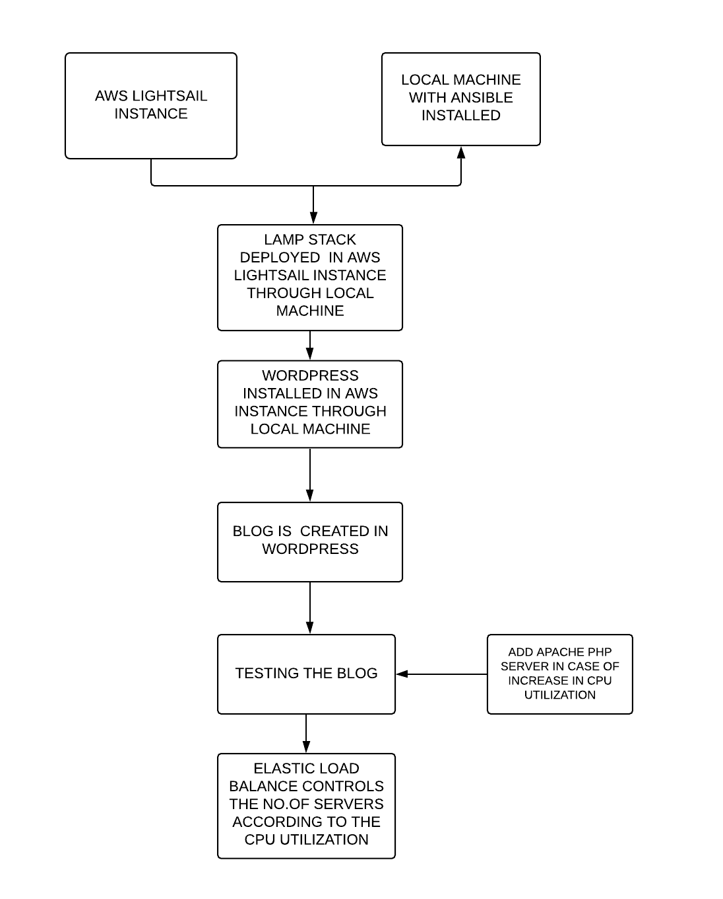
TECHNICAL WORKFLOW:

Slide 6
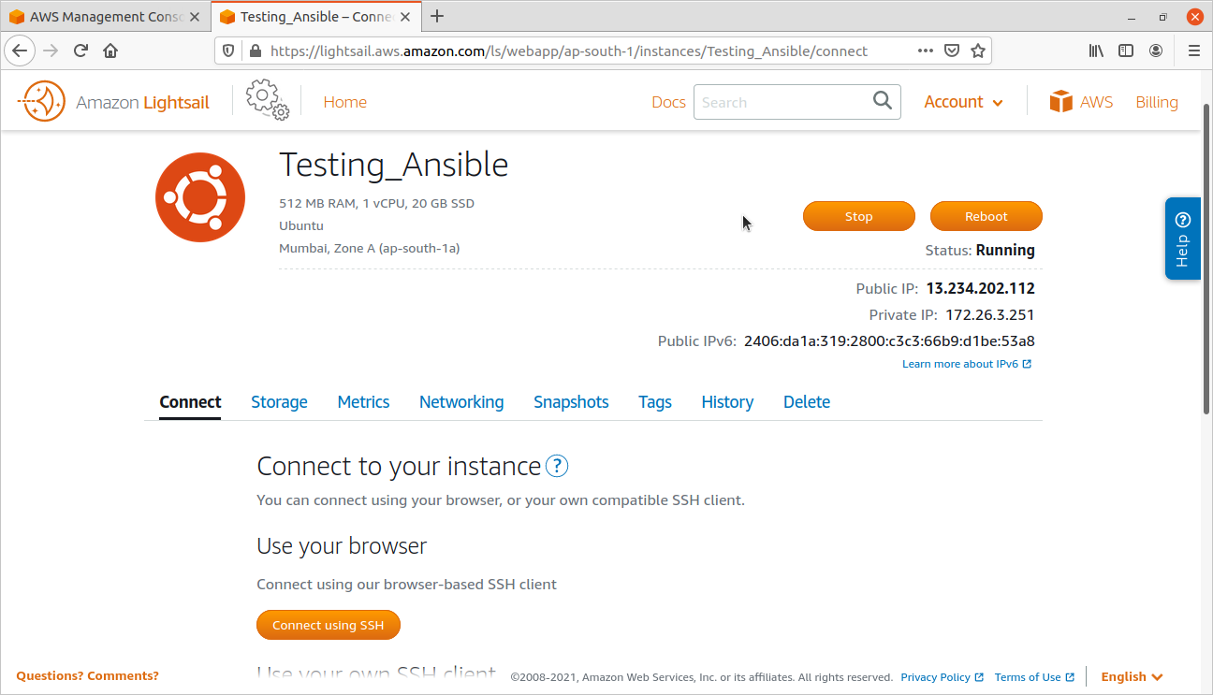
AWS Instance:

Slide 7
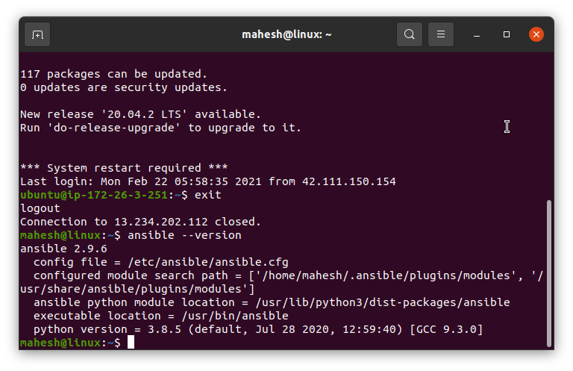
Ansible Installed in Local Machine:

Slide 8
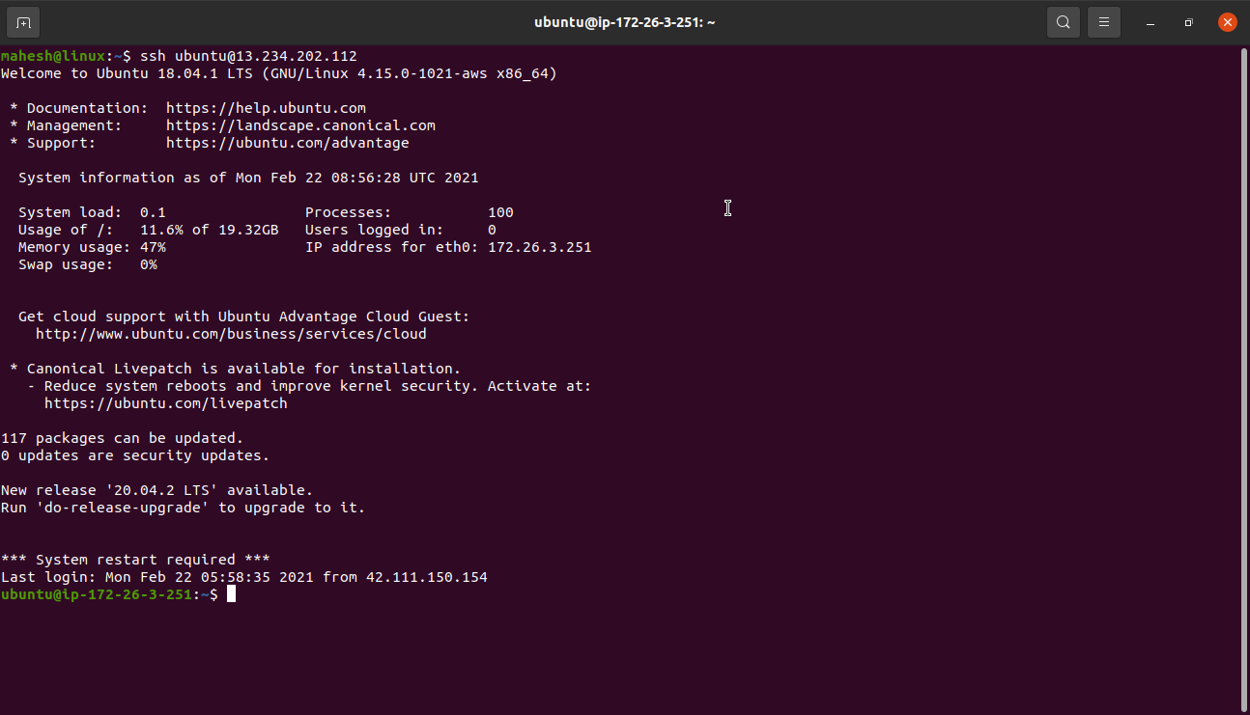
Connecting to an AWS Instance:

Slide 9
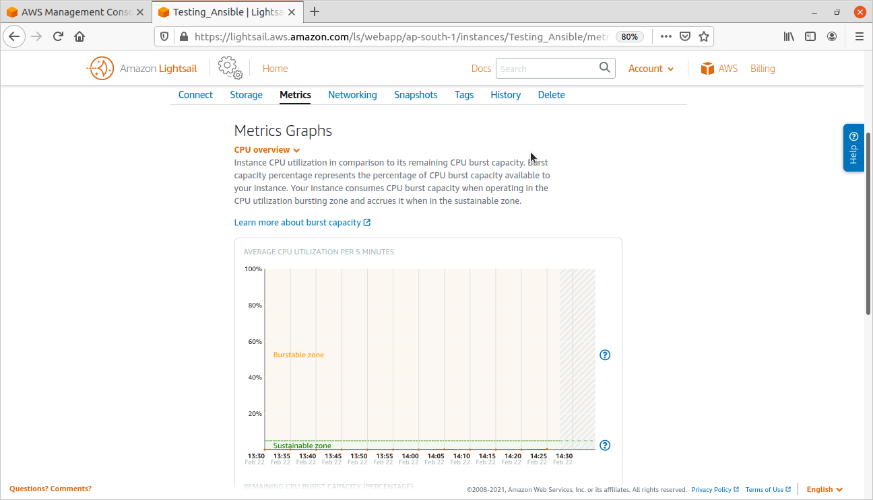
CPU Utilization in AWS Instance:

